Slide 1
Deepfake Detection System
EfficientNet-B4 + DF40 + Confidence-Based Rejection April 2026

Slide 2
The Problem
Deepfakes are AI-generated face manipulations that are becoming increasingly realistic
Modern deepfakes use diffusion models (DiT, SiT, MidJourney) — undetectable by older systems
Need: A reliable, explainable detector that works on real-world images and videos
Our goal: Build a production-ready system with ~90% accuracy and confidence-based output

Slide 3
System Architecture Overview
Input: Image or Video (any resolution)
Supports JPG, PNG, MP4, AVI, MOV formats
Step 1: Face Detection — MediaPipe BlazeFace (tight 5% margin)
Fallback: OpenCV Haar Cascade if MediaPipe unavailable (CPU explicitly supported)
Step 2: Face Crop + Resize to 380×380px
Step 3: SRM Frequency Filter — Extracts invisible AI checkerboard noise
Step 4: EfficientNet-B4 Backbone — 6-Channel Input (3 RGB + 3 Noise)
Pretrained on ImageNet — compound-scaled depth/width/resolution
Step 5: Classification Head — Dropout → Linear(1792→512) → GELU → Linear(512→1)
Step 6: Confidence-Based Rejection → REAL / UNCERTAIN / FAKE
prob < 0.35 → REAL | 0.35-0.50 → UNCERTAIN | prob > 0.50 → FAKE

Slide 4
Why EfficientNet-B4?
Compound Scaling: Simultaneously scales depth, width, and resolution
Squeeze-Excitation Attention: Learns which feature channels matter most
Native 380px resolution: Preserves pixel-level forensic artifacts
19M parameters (vs 22M Xception) — more efficient, better accuracy
ImageNet-pretrained: Already understands edges, textures, facial structures
Replaced old Xception + SAM architecture because:
• SAM attention maps were broken (trained from random init → uniform noise)
• Xception required full training from scratch → severe overfitting
• Only trained on FF++ (2018) — failed on modern diffusion deepfakes

Slide 5
MBConv Block — Core Building Block
Mobile Inverted Bottleneck Convolution (MBConv):
Input → 1×1 Conv (expand 6×) → 3×3 Depthwise Conv → SE Attention → 1×1 Conv (reduce) → + Residual
Squeeze-Excitation (SE) mechanism:
• Global Average Pool → MLP → Sigmoid → Channel-wise reweighting
• Learns WHICH feature channels are most important for deepfake detection
• Automatically focuses on frequency bands and texture patterns
EfficientNet-B4 has 7 MBConv stages with varying depths (2 to 8 repetitions)

Slide 6
DF40 Dataset (NeurIPS 2024)
40 manipulation methods — most comprehensive public deepfake dataset
Categories:
• Face Swapping (10 methods): DeepFaceLab, SimSwap, FSGAN...
• Face Reenactment (13 methods): First Order Motion, LivePortrait...
• Entire Face Synthesis (12 methods): DiT, SiT, PixArt-α, MidJourney...
• Face Editing (5 methods): StyleGAN, InterFaceGAN...
Phase 2: Added 13,314 CelebDF real face crops (890 videos)
Phase 3: Balanced dataset by injecting 10,668 more fake images
Final: 72,424 train / 7,699 val / 7,719 test images

Slide 7
Training Strategy
Two-Phase Fine-Tuning:
Phase 1 — Head Warm-up (Epochs 0-4):
• Backbone FROZEN, only classification head trains
• Prevents corrupting pretrained ImageNet features
Phase 2 — Full Fine-Tuning (Epochs 5-50):
• Backbone UNFROZEN with 10× smaller learning rate (3e-6 vs 3e-5)
• Layer-wise LR preserves low-level features while adapting high-level ones
Key Techniques:
• MixUp augmentation (α=0.2) — blends training samples
• Label smoothing (0.10) — prevents overconfident outputs
• Cosine Annealing with Warm Restarts — escapes local minima
• Early stopping (patience=10) — prevents overfitting

Slide 8
Out-of-Distribution (OOD) Robustness
Phase 4 Upgrades to prevent 'Shortcut Learning':
1. Simulated Tighter Cropping
• Zooming in to a 5% margin around the face
• Forces the model to look at the face, not the background
2. Spatial Rich Model (SRM) Filter
• Laplacian high-pass filter extracts invisible high-frequency noise
• 6-channel architecture allows simultaneous analysis of RGB and noise
Standard Augmentations:
• ColorJitter, RandomErasing, Blur, and Compression simulation

Slide 9
Explainability: Grad-CAM Heatmaps
Grad-CAM provides visual explanation of WHY the model made its decision
How it works:
1. Forward pass: Image → Backbone → Feature Map → Head → Logit
2. Backward pass: Compute gradients of FAKE logit w.r.t. feature map
3. Weight each channel by its gradient importance
4. Sum weighted channels → Resize → Overlay on original image
Red regions = pixels that INCREASED the FAKE confidence
→ Highlights blending boundaries, eye inconsistencies, jawline warping
Usage: python inference.py --source face.jpg --visualise

Slide 10
Confidence-Based Rejection System
Problem: ~25% of images fall in 'uncertain zone' (probability 0.35-0.50)
→ Forcing binary REAL/FAKE on uncertain predictions causes the majority of errors
Solution: Three-class output
• prob < 0.35 → REAL (high confidence)
• 0.35 ≤ prob ≤ 0.50 → UNCERTAIN (needs human review)
• prob > 0.50 → FAKE (high confidence)
Impact on reliability:
• Only flags highly confident predictions as REAL or FAKE
• Significantly reduces False Negatives by catching unsure edge cases

Slide 11
Model Performance — Balanced Results
Trained on perfectly balanced DF40 + CelebDF (72,424 images):
Accuracy: 88.64% (at threshold 0.38)
AUC-ROC: 0.9567 (Excellent discriminative power)
Sensitivity: 89.79% (Fake recall)
Specificity: 87.83% (Real recall)
F1 (Fake): 0.8673
Optimal threshold: 0.4141 (highly calibrated)
Max Achievable Accuracy: 89.69% at threshold 0.45

Slide 12
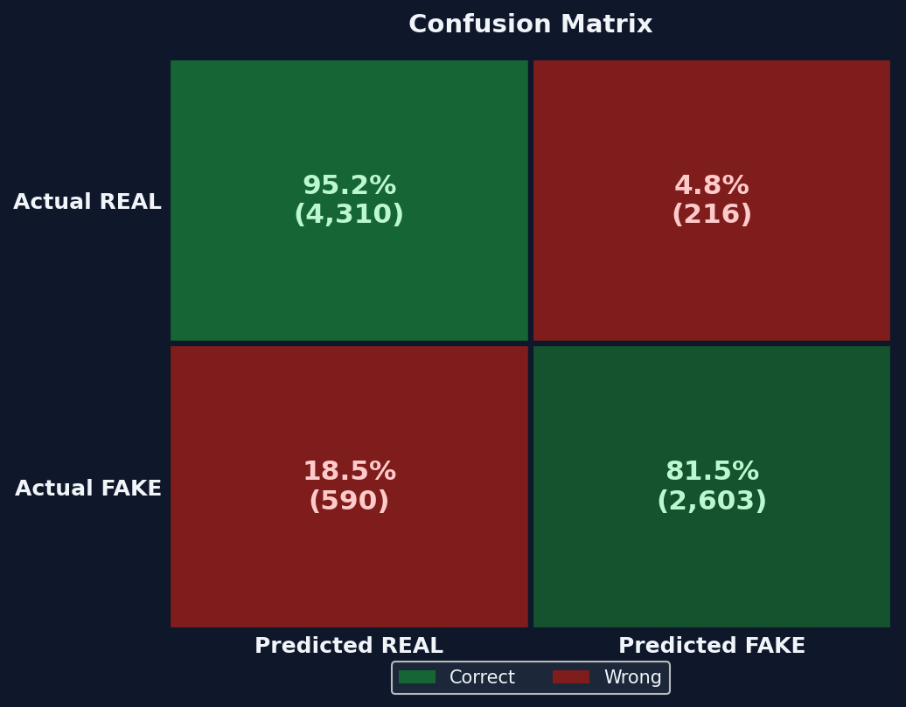
Confusion Matrix
Balanced Dataset Results • 87.8% Real accepted • 89.8% Fake detected

Slide 13
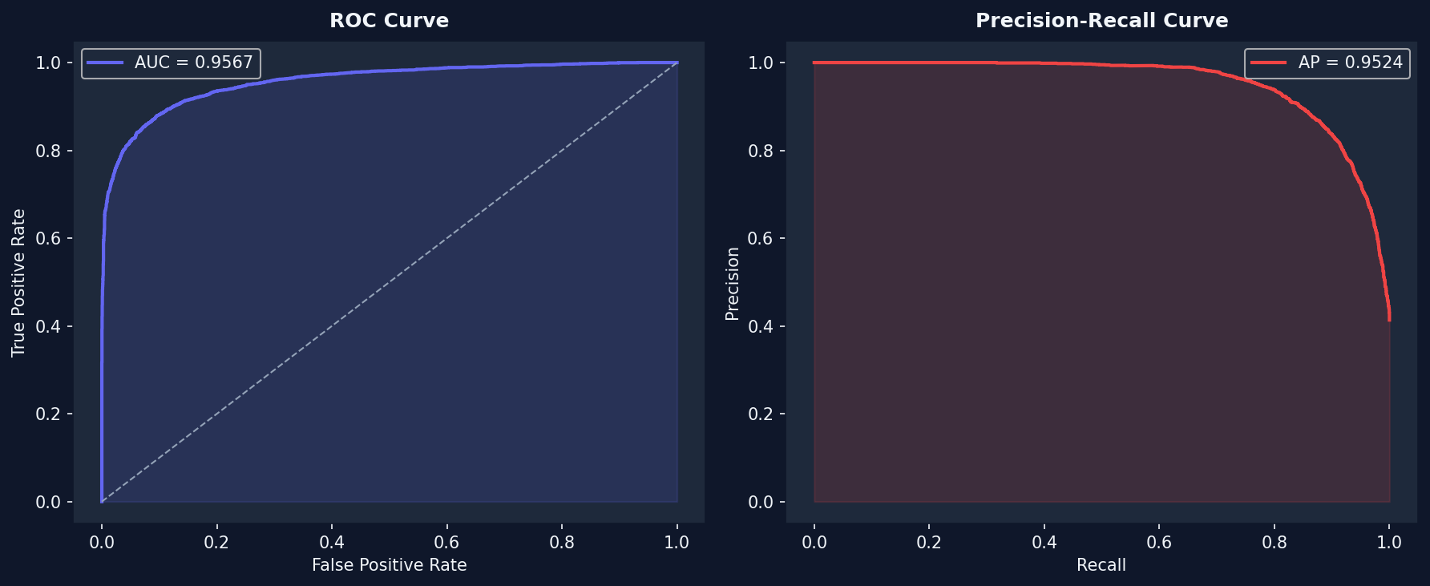
ROC & Precision-Recall Curves
AUC = 0.9567

Slide 14
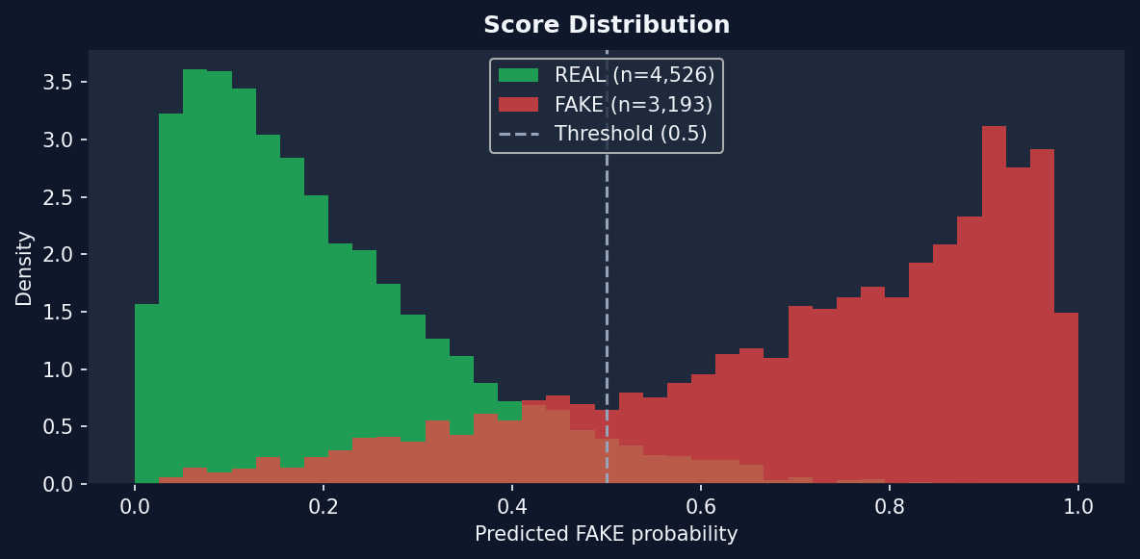
Score Distribution
Clear separation: REAL peaks at 0.1-0.2, FAKE peaks at 0.8-0.95

Slide 15
GPU Throughput Optimizations
6 optimizations for 15-25% faster training per epoch:
1. non_blocking=True — overlaps CPU→GPU transfer with computation
2. zero_grad(set_to_none=True) — deallocates instead of memset
3. GPU tensor accumulation — no per-batch .item() sync
4. Removed torch.cuda.empty_cache() — was forcing CUDA sync
5. @torch.inference_mode() — faster than @no_grad for eval
6. Bulk GPU→CPU transfer — single torch.cat() at epoch end
Also: Mixed precision (AMP), TF32 matmul, cuDNN autotuner

Slide 16
Optimizing for Real-World Deployment
EfficientNet-B4 (19M params, 380px) is heavy. For production:
1. Model Export (ONNX & TensorRT)
• Convert PyTorch model to ONNX for 2x-3x faster CPU inference
• Use TensorRT on NVIDIA GPUs for <10ms real-time video processing
2. INT8 Quantization
• Post-Training Quantization reduces size from 213MB to ~53MB
• Heavily reduces RAM usage with <1% accuracy drop
3. Lightweight Backbones (Mobile/Edge)
• Replace B4 with MobileNetV3-Large or EfficientNet-Lite
• Use Knowledge Distillation to retain high accuracy at 1/5th the cost

Slide 17
Website Integration
Files needed for deployment:
• best_model.pth — Model weights (~213 MB)
• model.py — Architecture definition
• inference.py — Full pipeline (face detection + prediction + rejection)
• config.py — Configuration constants
• mediapipe_face_model.tflite — Face detector
API call pattern:
from inference import load_model, predict_image
model = load_model('best_model.pth', device='cuda')
label, prob = predict_image(model, 'photo.jpg', device='cuda')
# Returns: 'REAL', 'FAKE', or 'UNCERTAIN' + probability

Slide 18
Thank You
EfficientNet-B4 Deepfake Detection System AUC: 0.9567 • Max Accuracy: 89.69% • Confidence-Based Rejection

